Slide 1
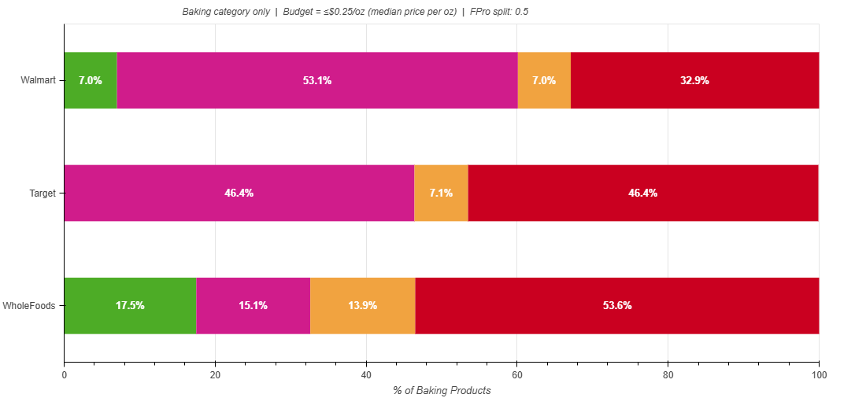
Budget Baking or Breaking the Bank:
Whole Foods has the highest share of baking products that are both budget friendly and less-processed
Product Classification
 | Less Processed | Ultra Processed
Budget
Pricier
%60.1 of baking products are budget friendly
Walmart provides
more budget friendly options overall.
Whole Foods is the only retailer with substantial share of products that are both budget friendly and less-processed.
Target contains the most ultra-processed items overall.
2.5x more budget friendly, less processed than Walmart
%92.8 of Target baking products are Ultra-Processed
*FPro (Food Processing Score) > 0.5 is used as the ultra-processed threshold, calculated from the min and max levels of the upper and lower classification levels.
Source: GroceryDB

